Slide 1
Presented by Maaz Habib & Mujtaba Abbas
Ransomware

Slide 2

Table of content
Definition
What is ransomware?
Evolution
Evolution and it’s types
How it works
Working of ransomware attacks
How to avoid
Avoidance and removal of ransomware
.MKP File Decryption
Challenges and Effective Strategies
Solution

Slide 3
01
What is ransomware?

Slide 4
“Ransomware locks the victim's files or their system, demanding a ransom payment to restore access.”
Ransomware typically encrypts files on the infected system, making them inaccessible without the decryption key held by the attacker.
There is however no guarantee of actual recovery, even after payment is made.
According to the 2023 Data Protection Trends Report, 85% of organizations suffered at least one cyberattack in the preceding twelve months.

Slide 5
02
Evolution of Ransomware

Slide 6
1989 - The AIDS Trojan
First created by Joseph Popp a Harvard-trained evolutionary biologist.
The ransomware was distributed by infected floppy disks.
It disguised itself as a program that offered a survey related to AIDS research.
It encrypted file names on the victim's computer.
The attack affected a relatively small number of victims compared to modern ransomware attacks but set a precedent for future cyber threats.
2014 - Crypto Wall
Utilized advanced encryption techniques, making it difficult to decrypt files without paying the ransom.
Primarily spread through phishing emails containing malicious attachments or links.
Crypto Wall caused significant financial losses worldwide by encrypting files on infected systems and demanding ransom payments in Bitcoin.

Slide 7
2018 - Targeted Attacks
SamSam:
Attacked specific sectors such as healthcare and government institutions.
Used brute-force attacks to gain access to networks.
GandCrab:
Used Ransomware-as-a-Service (RaaS) model.
GandCrab spread widely due to its RaaS model, affecting numerous users and organizations globally.
Shutdown: The creators of GandCrab announced its shutdown in mid-2019, claiming to have earned billions from ransom payments.
2020s-Current trends:
The involvement of encrypting files but also stealing sensitive data before encryption. Attackers threaten to leak this data if ransom demands are not met, increasing pressure on victims to pay.

Slide 8
02
Types of Ransomware

Slide 9
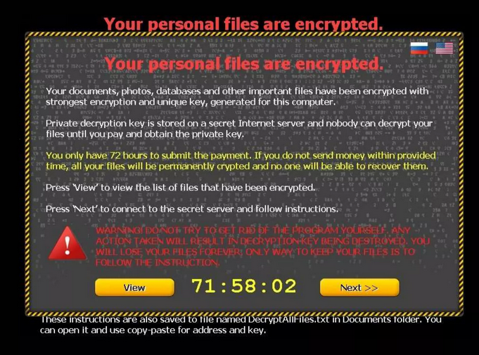
Encrypting Ransomware:
Encrypts files on the victim's system using strong encryption algorithms, rendering them inaccessible without a decryption key.

Slide 10
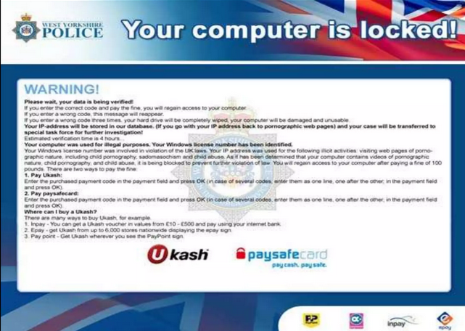
Locker Ransomware:
Locks the victim out of their system entirely, preventing access to files or the entire operating system.

Slide 11
03
How Ransomware works

Slide 12
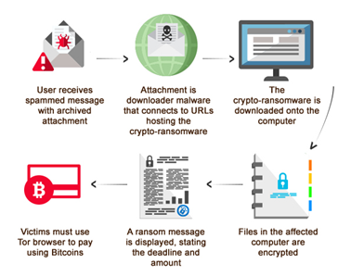

Slide 13
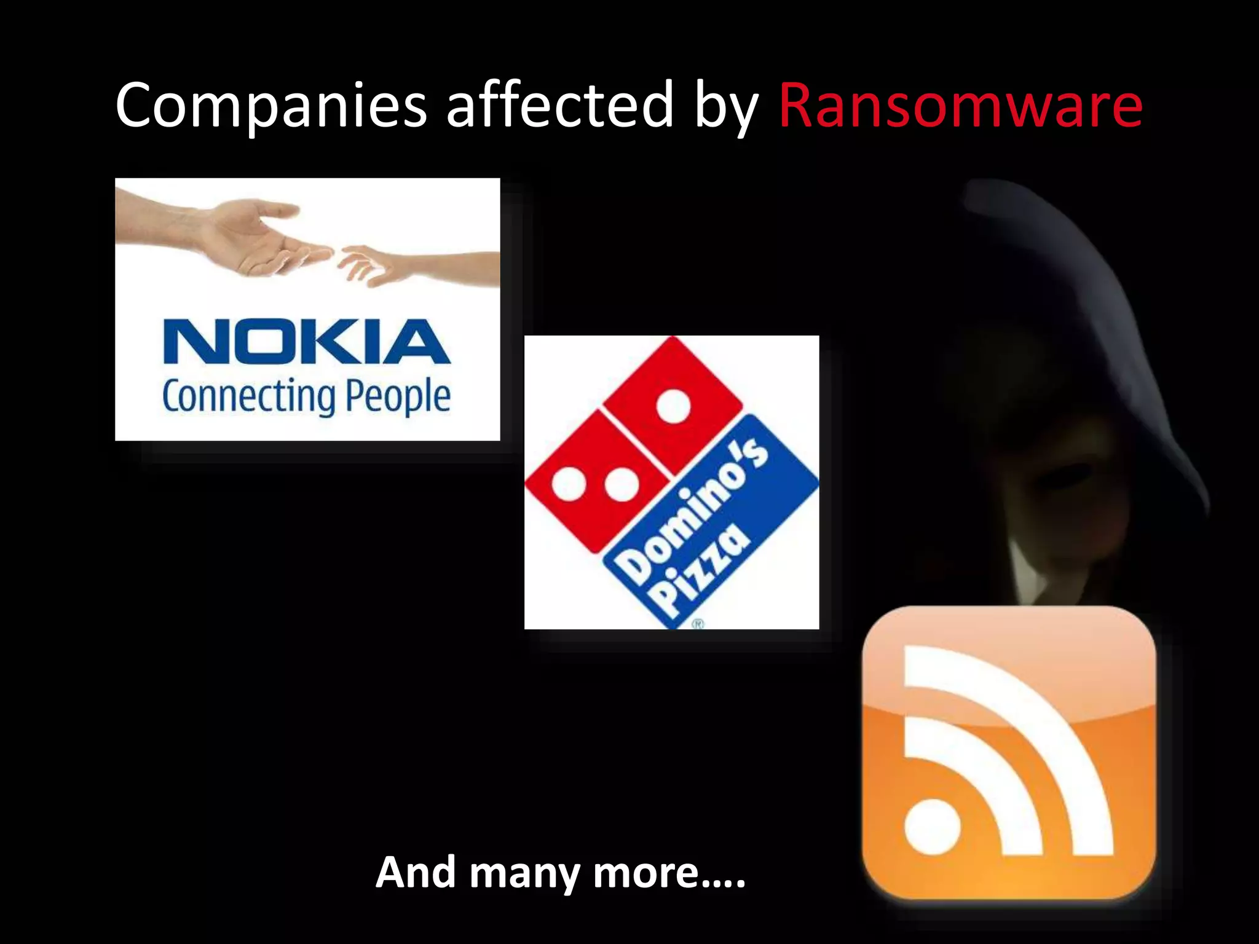

Slide 14
04
How to avoid

Slide 15
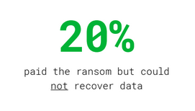
Regularly update your operating system, software, and antivirus programs to patch vulnerabilities that ransomware might exploit.
Keep backups of important files separate from your main system. This ensures you can restore your data without paying ransom if encrypted.
Learn about ransomware and share knowledge with family and colleagues to prevent accidental infections.
Have a response plan in place in case of a ransomware attack. This includes knowing how to disconnect from the internet and who to contact for support.
Even paying the ransom is not a guarantee that you’ll be able to recover.

Slide 16
05
MAKOP Origin and History

Slide 17
Makop ransomware was first identified in 2020. It targeted small to medium-sized businesses exploiting vulnerabilities in remote desktop protocols (RDP), evade detection by antivirus programs.
The ransomware spread through phishing emails, malicious attachments, and exploiting known vulnerabilities.
It operates under Raas model and has different variant with unique encryption methods.
Variants are recognized by extension and ransom note.
Some variants are ;
.Makop
.polite
.rezuc
.nakw

Slide 18
05
Challenges

Slide 19
Makop ransomware typically uses robust encryption algorithms e.g., AES, RSA.
There might be limited or no available decryption tools for certain variants for Makop ransomware, making it challenging to recover files without paying the ransom.
Even if a decryption tool is available, there is a risk that decrypted files may become corrupted or partially recovered.
AES encryption leaves no chance for the decryption, having 2^256 possible keys.
2^256= 115792089237316195423570985008687907853269984665640564039457584007913129639936

Slide 20
05
Effective Strategies

Slide 21
Immediately disconnect infected systems from the network to prevent the ransomware from spreading.
Turn off any remote access services or VPNs to prevent further unauthorized access.
Use Hex editors like HDX to open the files in raw form.
The raw form contains binary content of a file in hexadecimal format. This can be useful for analyzing the structure of files, identifying file types, and understanding how data is stored.
Security researchers use hex editors to reverse engineer malware.

Slide 22
05
Tool for ransomware

Slide 23
There are websites have offer public keys and tools for decrypting files. I.e.
No More Ransomware
ID Ransomware
Emsissoft
Bitdefender
Avast
Kaspersky

Slide 24
References
https://privacycanada.net/cryptanalysis/why-is-2-256-secure/
https://gridinsoft.com/ransomware/makop#:~:text=Just%20like%20a%20lot%20of,a%20brute%20force%2C%20for%20example
https://www.nomoreransom.org/en/ransomware-qa.html#solution
https://noransom.kaspersky.com/

Slide 25
06
Solution

Slide 26
Developing a Software using ML and AI to detect anomaly.
LSTM or SVM models have most accuracy (95%-100%)
Combination of Both Network and Host based Detection System to catch threat in real-time.

Slide 27
Thank you

